Slide 1

Creating Experiments with Goal Contingencies
This experiment demonstrates how you can use Goal objects to create contingencies. As you will see, the next set of Trials is determined by the Goal that is collected.

Slide 2
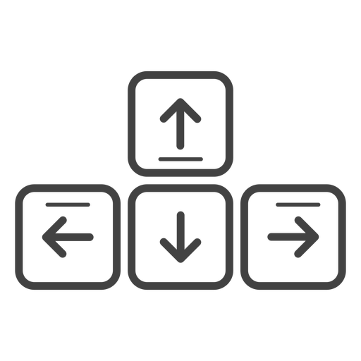
MOVEMENT CONTROLS
To navigate the environment, use the Up-Arrow to move forward, the Down-Arrow to move backwards and the Left-Arrow and Right-Arrow to rotate.
Move Forward
Rotate
Left
Rotate
Right
Move Backward
PRESS THE SPACEBAR TO CONITUE

Slide 3
Now Entering the Red Enclosure

Slide 4
Now Entering the Blue Enclosure

Slide 5
Now Entering the Purple Enclosure

Slide 6
Now Entering the Yellow Enclosure

Slide 7
Now Entering the Cyan Enclosure

Slide 8
End of Experiment

Slide 9
BACK TO THE START!

